Slide 1
Computer Science
Sorting
Samuel Lukas

Slide 2
Types of Sorting
Simple sort
Insertion sort & Selection sort
Distribution sort
Counting sort, Bucket sort & Radix sort
Bubble sort
Bubble sort, Shell sort & Comb sort
Efficient sort
Merge sort, Heap sort & Quick sort

Slide 3
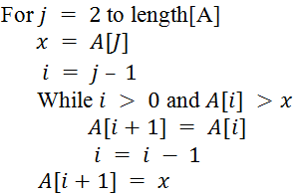
Insertion Sort
Data
5
2
4
6
1
3
5
2
4
6
1
3
2
5
4
6
1
3
2
4
5
6
1
3
2
4
5
6
1
3
1
2
4
5
6
3
1
2
3
4
5
6

Slide 4
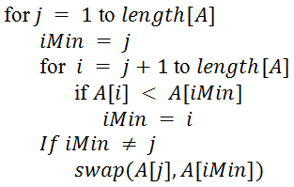
Selection Sort
Data
65
25
12
22
11
11
25
12
22
64
11
12
25
22
64
11
12
22
25
64
11
12
22
25
64
11
12
22
25
64

Slide 5
Counting Sort
Suppose data is integers and less than 30 but number of data is 30 : Array A
Array temp : storing number of occurrence of each data Array C
Array stores cumulative number of occurrence of each data less than or equal to
Array sorted data Array B

Slide 6
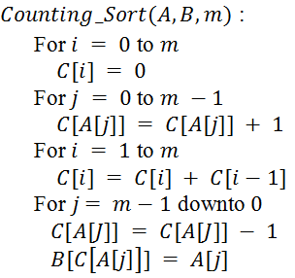
Counting Sort
Suppose data is integers and less than 30 but number of data is 30 : Array A
Array temp : storing number of occurrence of each data Array C
Array stores cumulative number of occurrence of each data less than or equal to
Array sorted data Array B

Slide 7
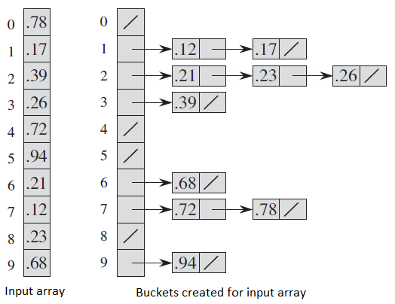
Bucket Sort
0.12, 0.17
0.21, 0.23, 0.26
0.39
0.68
0.72, 0.78
0.84

Slide 8
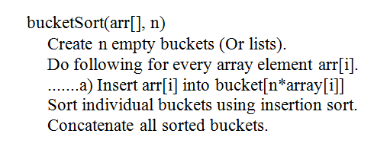
Bucket Sort
0.12, 0.17
0.21, 0.23, 0.26
0.39
0.68
0.72, 0.78
0.84

Slide 9
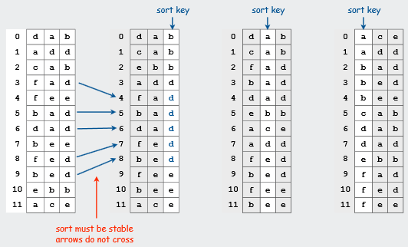
Radix Sort

Slide 10
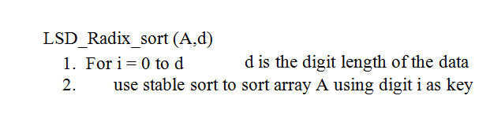
Radix Sort

Slide 11
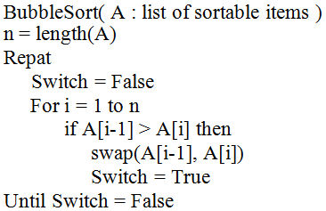
Bubble Sort

Slide 12
Shell Sort
54
26
93
17
77
31
44
55
20
Gap = 3
17
26
93
44
77
31
54
55
20
17
26
93
44
55
31
54
77
20
17
26
20
44
55
31
54
77
93
Gap = 1
17
26
17
20
26
17
20
26
44
Insertion sort
17
20
26
44
55
17
20
26
31
44
55
17
20
26
31
44
54
55
77
93

Slide 13
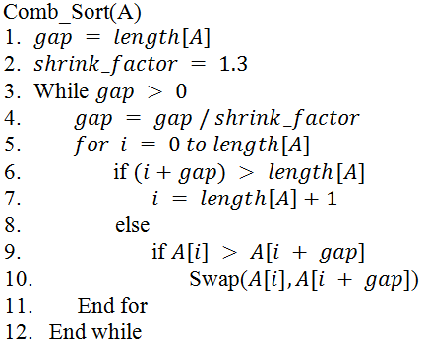
Comb Short
Combination between Shell sort and Bubble sort
Data Gap
33 98 74 13 55 20 77 45 64 83
10/1.3 = 7
77
55
7/1.3 = 5
33 64 74 13 55 20 77 45 98 83
45
33
98
20 64 45 13 55 33 77 74 98 83
5/1.3 = 3
55
3/1.3 = 2
13 55 33 20 64 45 77 74 98 83
20
45
74
83
13 20 33 45 64 55 77 74 98 83
2/1.3 = 1
13 20 33 45 55 64 74 77 83 98
Bubble sort 1 x

Slide 14
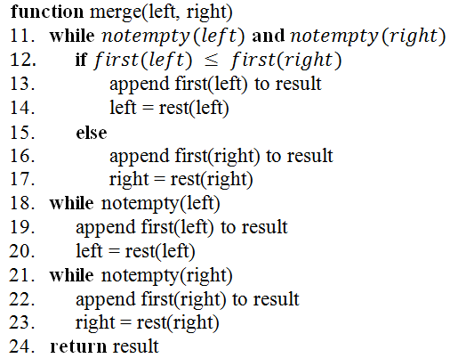
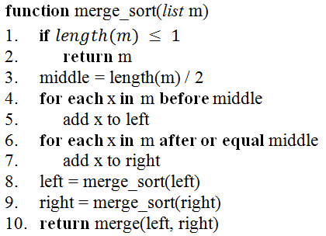











Merge Sort

Slide 15
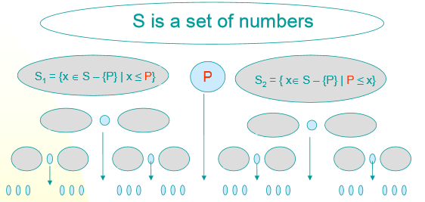
Quick Sort

Slide 16
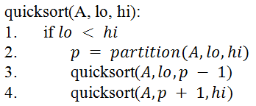
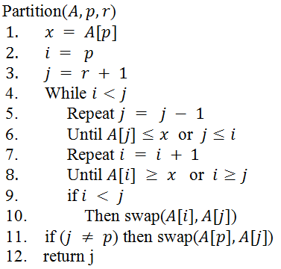
Example of Quick Sort
65 | 70 | 75 | 80 | 85 | 60 | 55 | 50 | 45
60 | 45 | 50 | 55 | 65 | 85 | 80 | 75 | 70
55 | 45 | 50 | 60 | 65 | 85 | 80 | 75 | 70
50 | 45 | 55 | 60 | 65 | 85 | 80 | 75 | 70
45 | 50 | 55 | 60 | 65 | 85 | 80 | 75 | 70
45 | 50 | 55 | 60 | 65 | 70 | 80 | 75 | 85
45 | 50 | 55 | 60 | 65 | 70 | 80 | 75 | 85
45 | 50 | 55 | 60 | 65 | 70 | 75 | 80 | 85

